Slide 1
Odd’s n’ Ends*

Slide 2
Idioms
Rom 5:12
“Just as sin came into the world through one man, and death through sin, and so death spread to all men, because (ἐφ᾿ ᾧ) all have sinned —”

Slide 3
Partial Inflection
nom sg Λευίς
gen sg Λευί
dat sg Λευί
acc sg Λευίν

Slide 4
Uninflected
ἀββά
Ναζαρέθ
ῥαββουνί

Slide 5
8 Case System
Four distinct forms
Eight ideas
Ablative (“from”)
Locative (“in”)
Instrumental (“by”)

Slide 6
Conditional Sentences
If (protasis)
Then (apodosis)
Four categories

Slide 7
First Class
εἰ in the protasis
Truth of the protasis is assumed for the sake of the argument

Slide 8
First Class
Matt 5:30
“If (εἰ) your right hand causes you to sin, cut it off and throw it away from you.”

Slide 9
First Class
1 Cor 15:13
“If (εἰ) there is no resurrection of the dead, not even Christ has been raised.”

Slide 10
First Class
1 Thess 4:14
“For if (εί) we believe that Jesus died and rose again, so also do we believe that God will bring with him those who have fallen asleep in Jesus.”

Slide 11
Second Class
εἰ in the protasis
Truth of the protasis is assumed to be true, even though it is false, for the sake of the argument

Slide 12
Second Class
1 Cor 2:8
“None of the rulers of this age understood it, for if (εἰ) they had, they would not have crucified the Lord of glory.”

Slide 13
Third Class
ἐάν + subjunctive in the protasis
Two types
Present general: generic situation in the present time
More probable future: specific situation in future (more probable)

Slide 14
Third Class: Present General
1 John 1:9
“If we confess (ἐὰν ὁμολογῶμεν) our sins, he is faithful and just and will forgive us our sins and cleanse us from all unrighteousness.”
“might”

Slide 15
Third Class: More Probable
Luke 5:12
“Lord, if you are willing (ἐὰν θέλῃς), you can make me clean.”

Slide 16
Word Order
Conjunction + verb + subject + object
Why so many initial conjunctions are not translated
Alter for emphasis
Nuance
Emphasis

Slide 17
Word Order
Conjunction + verb + subject + object

Slide 18
Emphasis
1 Tim 2:4
God “wishes all people to be saved.”
ὃς πάντας ἀνθρώπους θέλει σωθῆναι.

Slide 19
Emphasis
Gal 2:19a
“For through the law I died to the law so that I might live for God.”
ἐγὼ γὰρ διὰ νόμου νόμῳ ἀπέθανον, ἵνα θεῷ ζήσω.

Slide 20
Emphasis
Rom 1:17c
“The righteous shall live by faith” (ESV).
ὁ δὲ δίκαιος ἐκ πίστεως ζήσεται

Slide 21
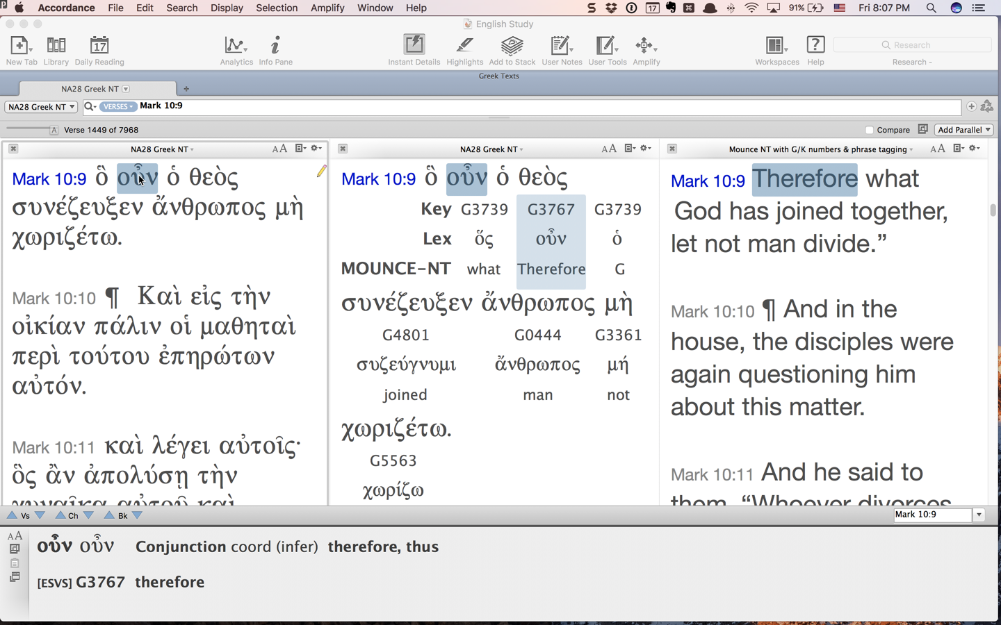
Odds n’ Ends: Postpositives

